Slide 1
Food Waste Prevention and Recovery Grant
Information Session
2/5/2026

Slide 2
Today’s Agenda
Who we are
+ Purpose
+ Eligibility
+ Evaluation Criteria
Food Waste Prevention and Recovery Grant
Q&A
+ Requirements
+ Application Process

Slide 3
Who is Ramsey/Washington Recycling & Energy?

Slide 4
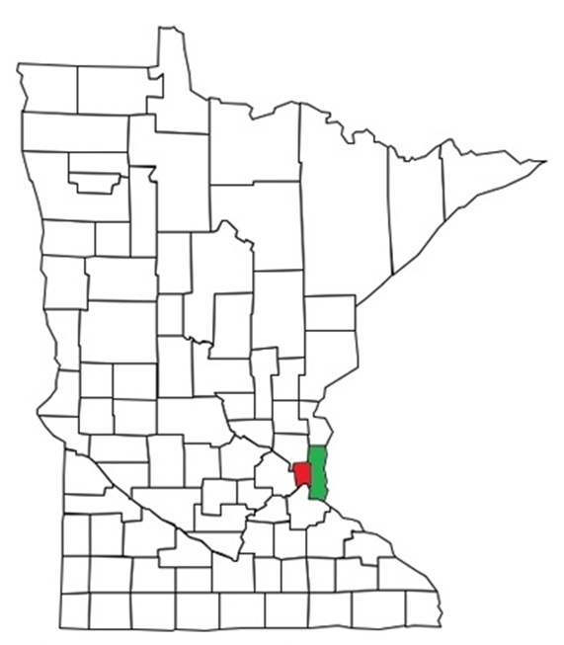
Ramsey/Washington Recycling & Energy
Ramsey and Washington counties have worked together to manage trash responsibly since the 1980s.
Over 800,000 residents and 70,000 businesses
14% of state's population
Public entity responsible for meeting the state of MN’s goal to recycling 75% of solid waste by 2030.
Overseen by a joint powers board of Ramsey & Washington County Commissioners.

Slide 5
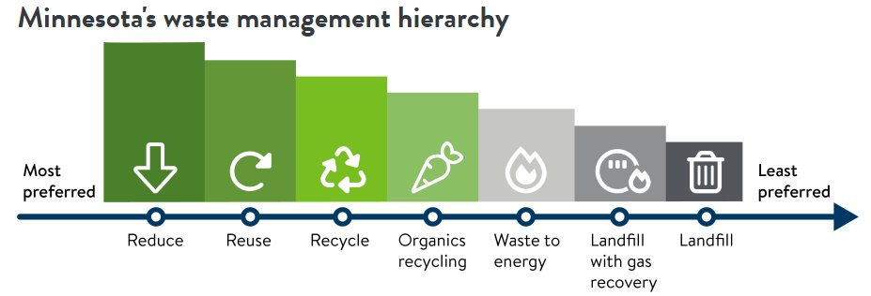
Ramsey/Washington Counties Solid Waste Priorities
Top Priority – Upstream
Waste reduction, reuse, and repair (75% Recycling Goal)
Source-separating recycling – reusable items, recyclable items, and food scraps
Outreach and education – behavior change
Last Option - Downstream​
Processing waste for energy​
Pulling valuable materials from the waste stream​
Landfilling as a last resort

Slide 6
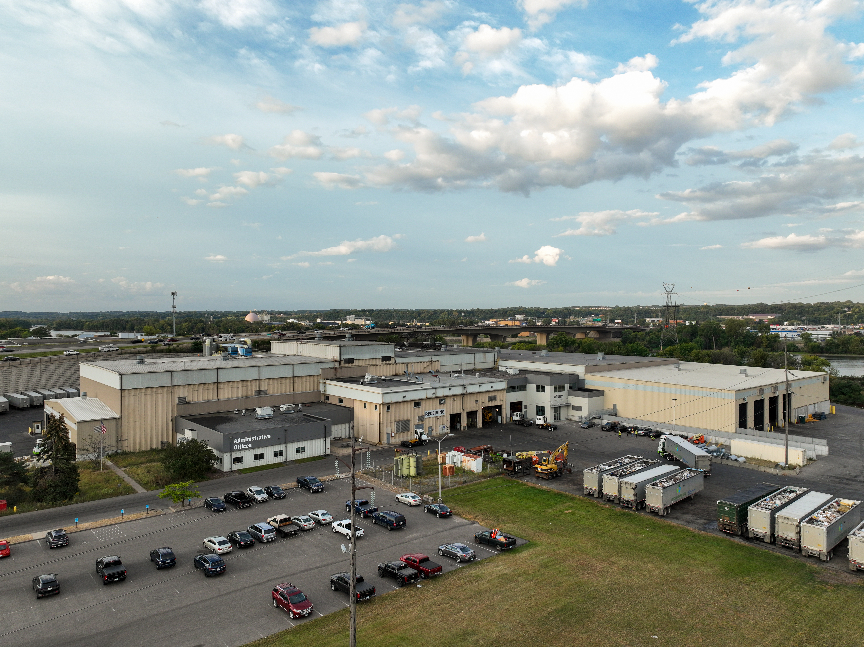
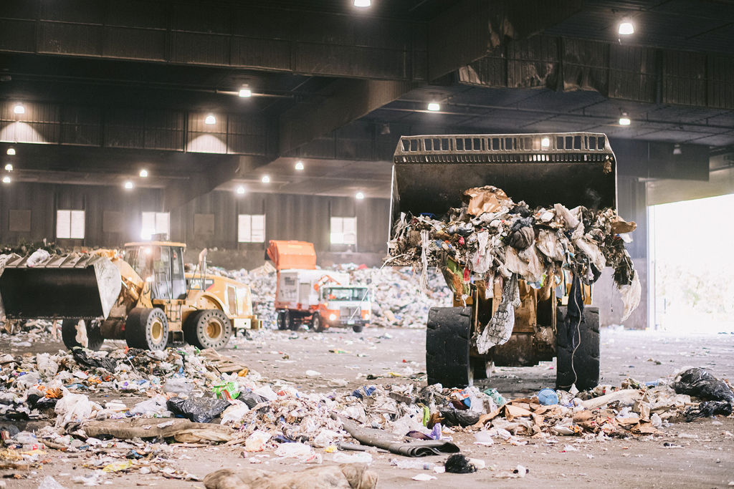
The R&E Center (Downstream Processing)
Located in Newport, MN
Purchased by the two counties in 2016
All trash from residents and businesses in the two counties is delivered here
Trash is processed into refuse-derived fuel (RDF) used by Xcel Energy to generate electricity
About 10% is landfilled
R&E Center manages nearly 13% of the state's total waste

Slide 7
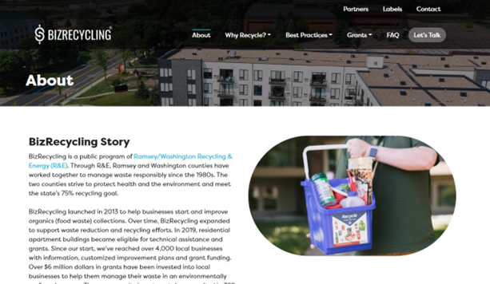
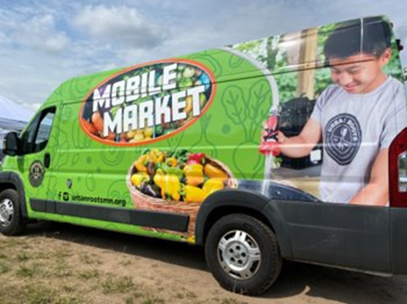


Community Programming (Upstream Prevention Work)
BizRecycling
Business Pollution Prevention
Food Waste Prevention
Food Scrap Recycling
Compost Market Development
Mattress Recycling
Deconstruction/C&D Recycling
Reuse & Repair
Outreach and Education

Slide 8
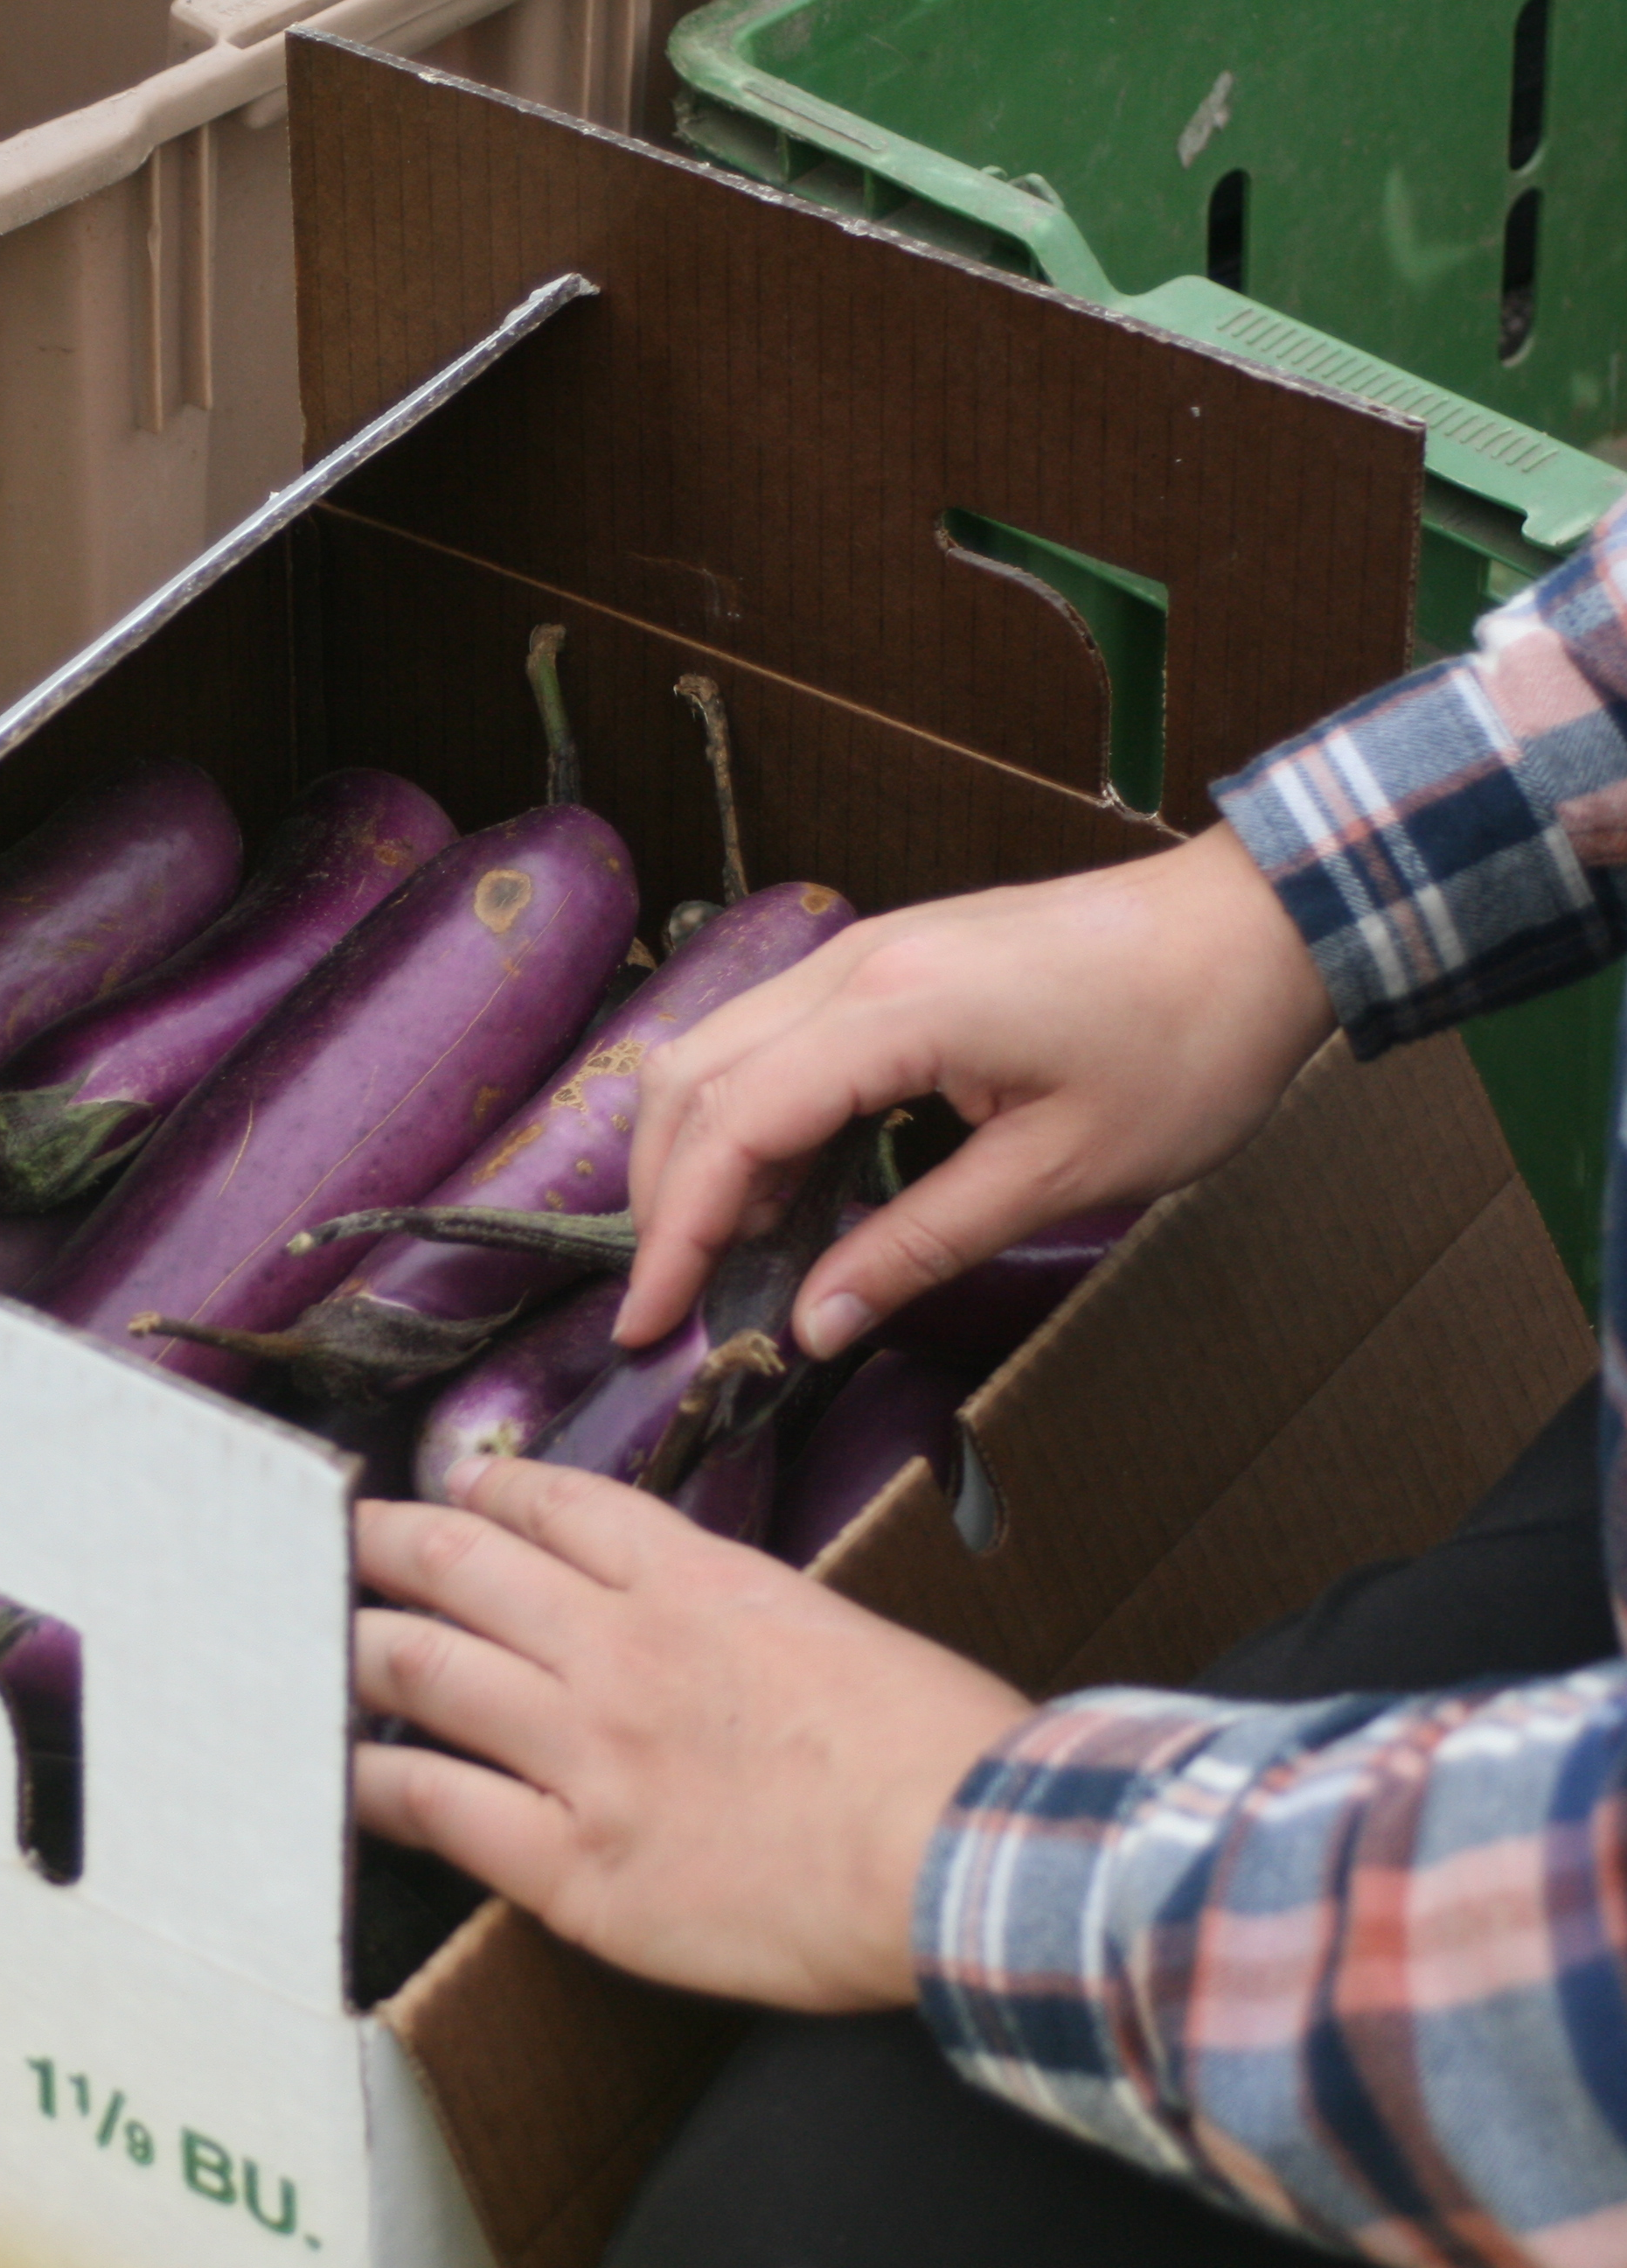
Food Waste Prevention
Food Recovery Partners
  Yearly partnership to recover and divert food
BizRecycling - Food Waste Prevention and Recovery Grants
  Technical assistance and grant funding for commercial sector entities
  Technical assistance and grant funding for apartment buildings

Slide 9

Food Waste Prevention
Additional resources
  Recyclingandenergy.org/food-waste-reduction/

Slide 10
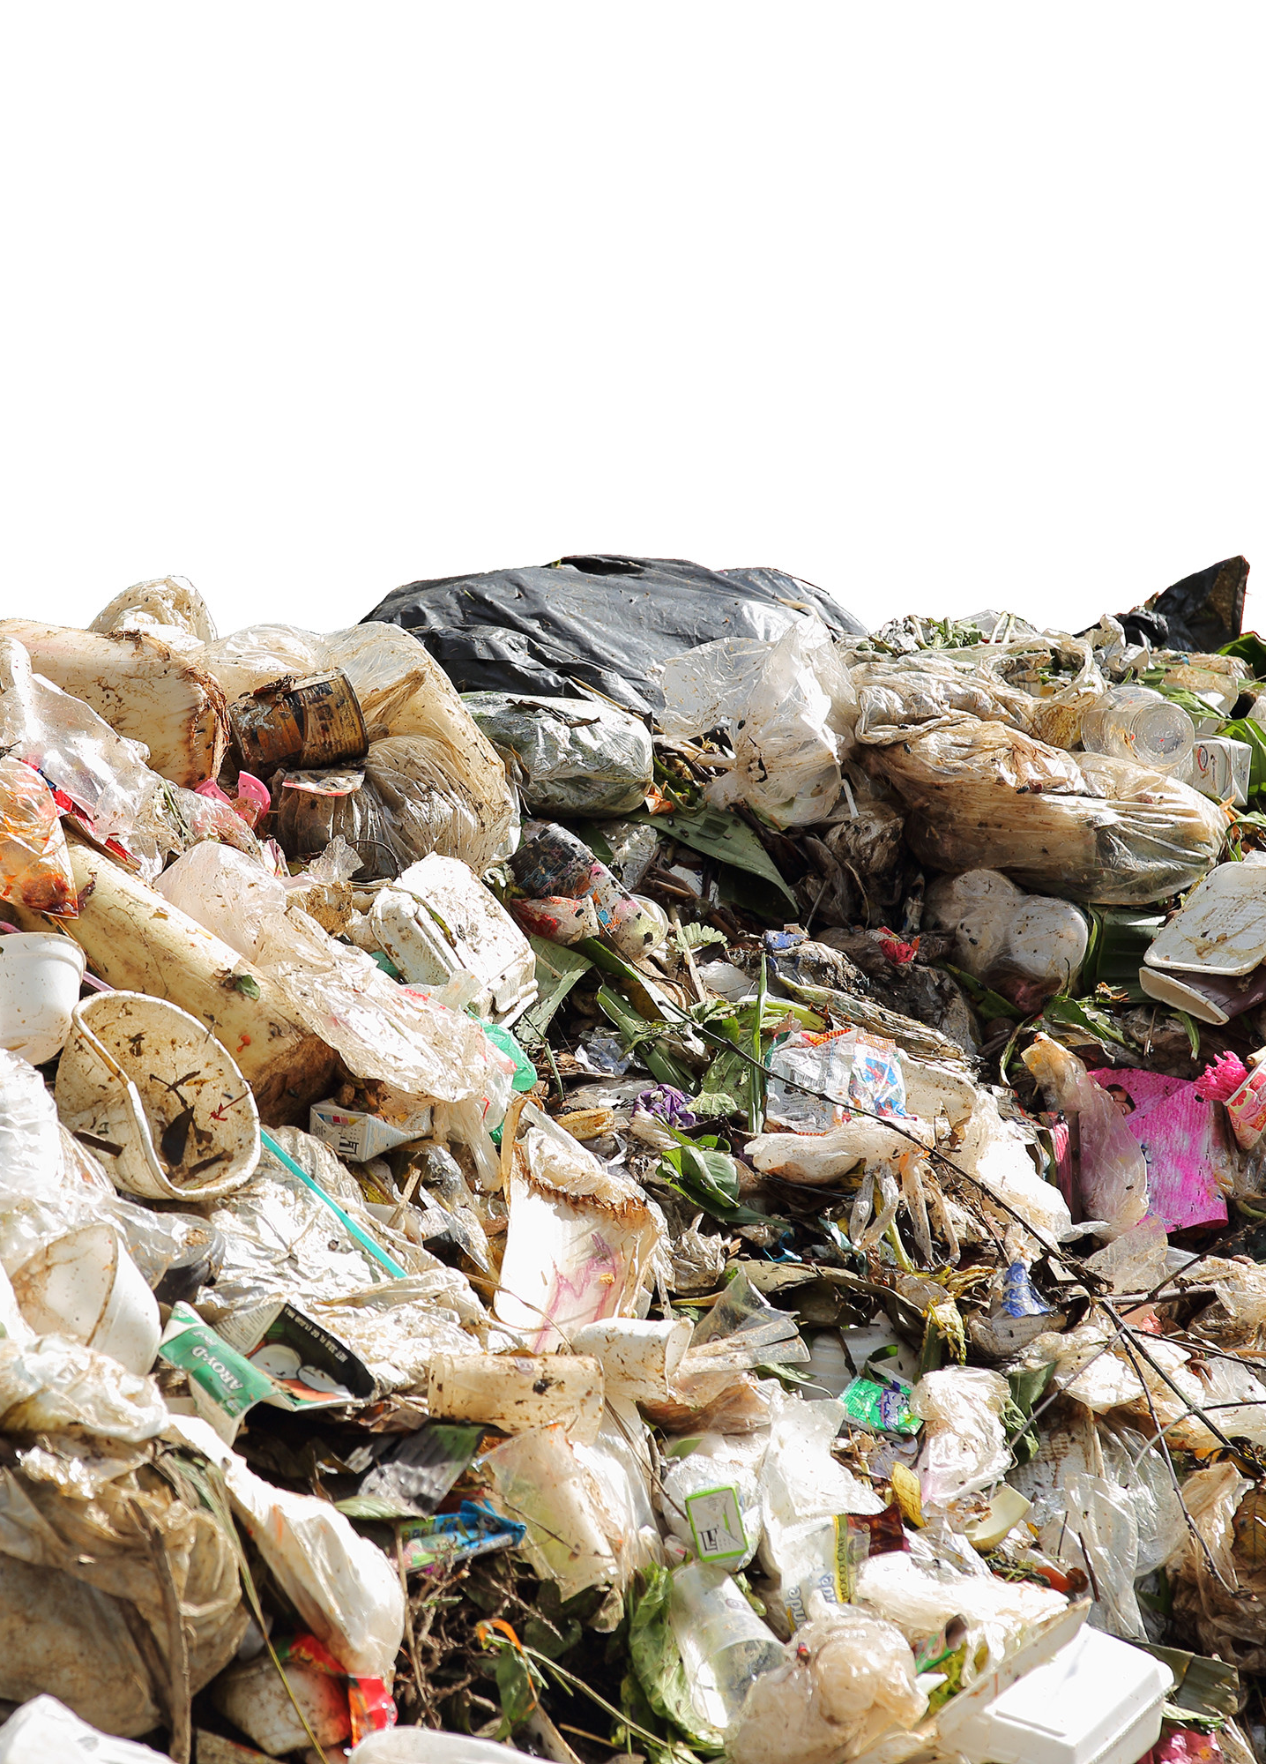
Why food waste reduction?
30% of U.S. produced food is thrown away
24.5% of residential waste at R&E is food
28.4% of commercial waste at R&E is food
In Minnesota, about 62% of food arriving at landfill is edible
Methane emissions from landfilled food
Food insecurity in Ramsey & Washington counties

Slide 11
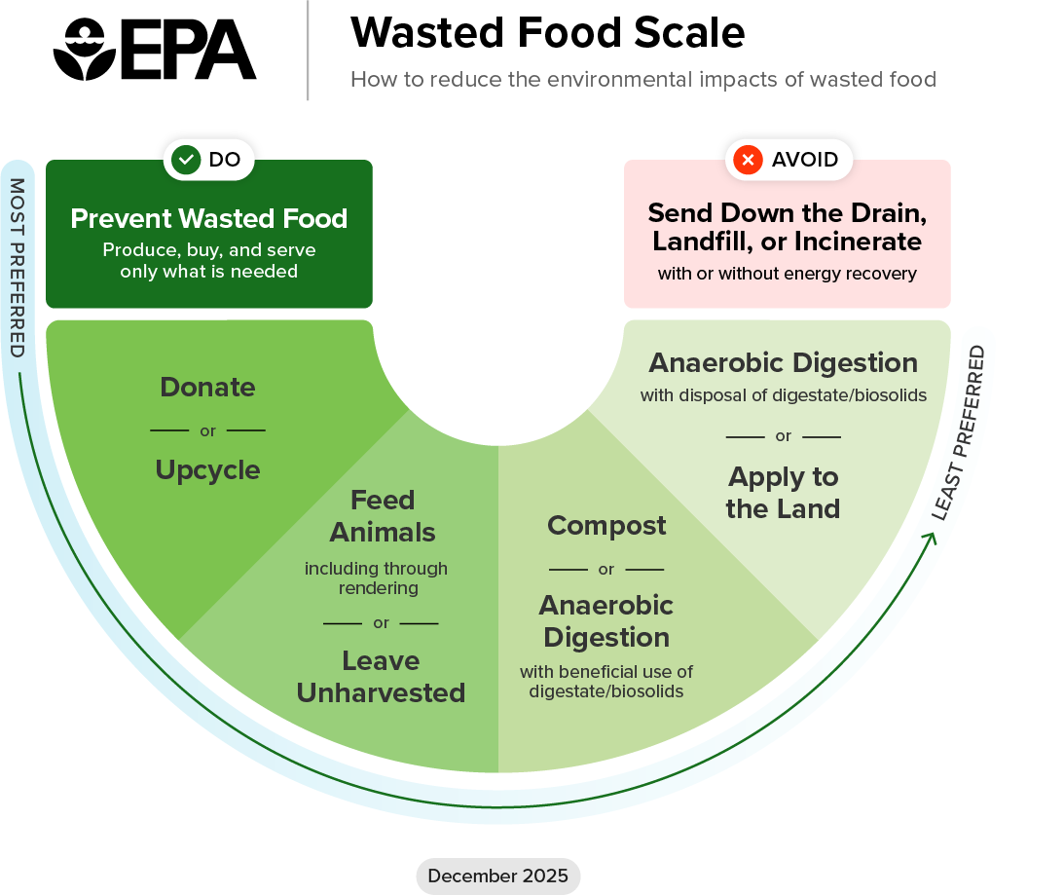
Program Goals
Support recovery of surplus, edible food from businesses, organizations and farmer's markets for distribution to people in need in Ramsey and Washington counties
Prevent edible food from entering the waste stream in Ramsey and Washington counties
Preserve food for its intended and preferred use: for consumption by people

Slide 12
Food Waste Prevention and Recovery Grant

Slide 13
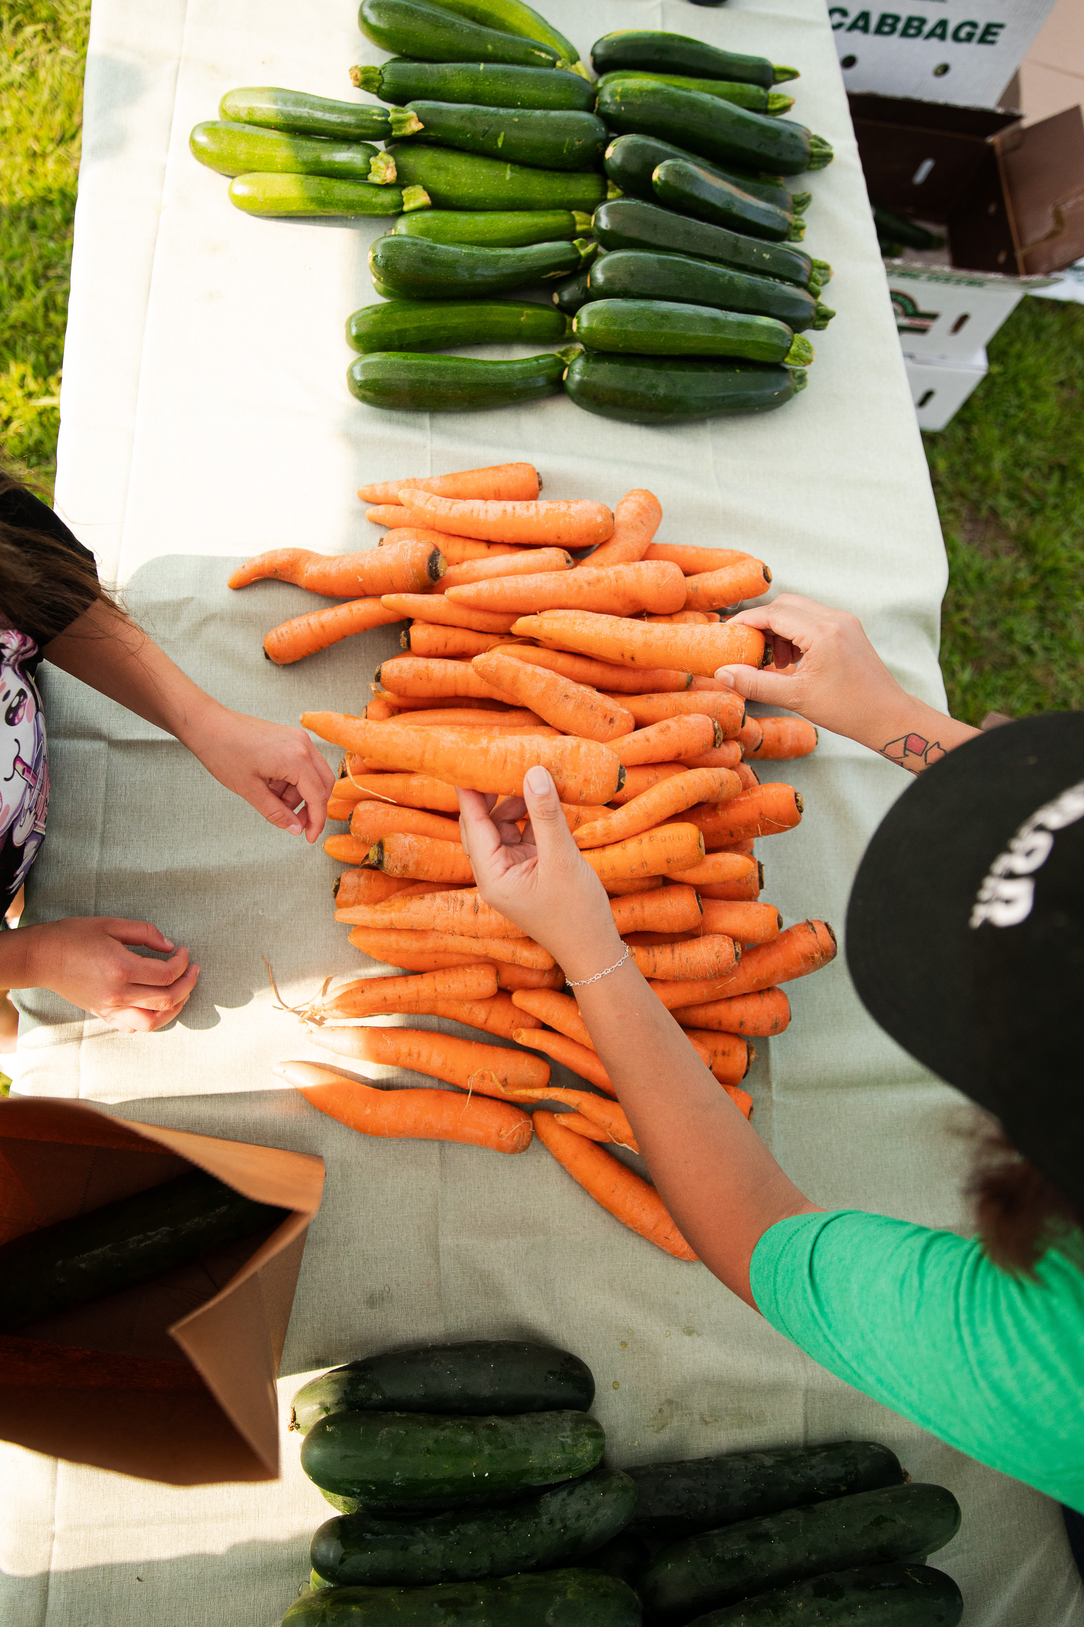
Food Waste Prevention and Recovery Grant
Formerly known as Food Recovery Grant
Impact (since 2021)
60 grants awarded
10,196,344 pounds of food waste prevented
  Number of pounds from 2021-2024

Slide 14
Food Waste Prevention and Recovery Grant
Definitions
Food Recovery: collection of edible, surplus food from grocery stores, distributors and other sources for distribution to people in need.
Gleaning: the harvest and/or recovery of edible, surplus produce from farms and/or farmers' markets for donation to people in need.

Slide 15

Food Waste Prevention and Recovery Grant
Launched in 2021 in response to increased food waste and food insecurity
Purpose: Recover surplus, edible food for distribution to people who need it.
Who can apply? Food donors (food producers, distributors, grocers, cafeterias, farmers markets), nonprofit organizations, and college food shelves
  Must recover and/or donate food in Ramsey or Washington County

Slide 16
Food Waste Prevention and Recovery Grant
Ineligible applicants
  Individuals
  Home-based cottage food businesses
  Government organizations
  Restaurants
  Food Recovery Partners
Restaurants are eligible for funding through BizRecycling Grants for food recovery
  Talk to your BizRecycling Expert for additional details

Slide 17

Funding Limits
Up to $20,000 awarded per application
  Projects must start or expand food recovery/gleaning initiatives
  Up to $5,000 for community capacity, innovation, and education
  50% of grant award is provided at project start, 50% via reimbursement ($250 for final report)
Previous applicants may reapply in the grant cycle after contract ends

Slide 18
Grant Requirements
Work with a technical assistance provider
  Initial site visit
  Application support
  Implementation support
  Reporting support
Complete a Food Waste Prevention and Recovery Grant application
Enter into a contract agreement with R&E for a period of 12 months
  Biannual (every six months) reports
  Proof of Funds Spent form
  Follow-up site visit
  Final report

Slide 19
Evaluation criteria | What we're looking for
Increase food recovery (food donated, received, and distributed): Estimated weight in pounds of food that will be recovered with support of project funds. | Calculations of estimated food recovered are very clear. Estimation of food recovered is realistic regarding project activities. Estimated food recovered with proposed activities represents at least a 20% increase in overall recovery of the applicant.
Support recovery of healthy and/or culturally relevant foods: Project activities result in significant gains to healthy and/or culturally relevant foods recovered. | Project activities significantly increase healthy and/or culturally relevant foods recovered. Donation partners include more than three cultural grocers and/or farmers.
Partnership/collaboration: Project activities demonstrate new or expanded opportunities for partnership or collaboration. | Project activities include at least three new or expanded opportunities for partnership or collaboration.
Increase community capacity for/knowledge of food recovery and food waste prevention best practices: Activities described in the application help staff and/or community increase their capacity for/knowledge of food recovery best practices. | Proposed activities include clearly identifying multiple opportunities for staff and/or community to increase their capacity/knowledge of food recovery best practices through training, certification, new process implementation, or other identified means. Project activities clearly demonstrate the potential to be replicated in other organizations or communities.

Slide 20
Evaluation Criteria | What we're looking for
Activities: project activities are clearly stated, specific, realistic, and measurable | The activities described are very clear, concise, and easy to understand. Project activities, including current and proposed operations, equipment, and processes, are explained. Very clearly defines the link between project activities and how food waste will be reduced.
Sustainability: project can be sustained beyond the grant period | Evidence presented that the project can be sustained beyond the grant period. Gains in food recovered are continued after the grant period.
Budget: budget clearly supports project activities and impacts, and items are eligible for funding | Budget clearly supports project activities and impacts. Items are eligible for funding.

Slide 21
2026 Guidelines
Eligible expenses
  Transportation costs: Mileage reimbursement, vehicle rental or purchase
  Equipment for use in food donation/recovery efforts such as: Energy Star rated fridges/freezers, shelving, carts, reusable pallets, pallet jacks, etc.
  Equipment installation costs
  Supplies: reusable buckets, boxes, etc.
  Storage costs: Storage equipment/facilities rental and/or purchase
  Equipment and materials for processing recovered food for preservation, value-add, or upcycling up to $10,000
  Taxes and shipping costs up to 10%, included as a separate line-item in application
  Staff training: two hours of training at hourly wage for each employee for R&E-approved trainings about food waste prevention including topics such as food safety, gleaning, extending food shelf life, and managing inventory/first in first out
  Staff time: up to $20,000 or equivalent of 0.5 FTE, whichever is less, for work directly associated with food recovery and gleaning activities
  Repairs to food recovery equipment (fridges, freezers, etc.) up to $750
  Other expenses as approved by R&E

Slide 22
2026 Guidelines
Eligible expenses for community capacity, innovation, or food waste prevention education projects (up to $5,000)
  Staff time: available up to project maximum of $5,000 for developing food waste prevention education materials, preparing for and facilitating workshops, providing food waste prevention resources (tabling, staff training, etc.), developing resources to better coordinate volunteers, etc.
  Project materials: supplies for workshops such as cooking/canning materials, reusable tubs for food donation sorting demonstrations, etc.
  Capacity building and innovation: volunteer outreach/coordination specific to food recovery/gleaning activities; development of organization-wide best practices for food recovery/gleaning; food waste tracking software implementation, etc.
  Participation incentives related to food waste prevention such as magnets demonstrating where to properly store food to maximize shelf life, reusable food storage containers, etc.

Slide 23

Application Overview
Organization description
Describe organization mission, communities served, and geographic reach
Food recovery activities
Describe activities organization plans to carry out with grant funds and expected outcomes
Tips:
Be clear and thorough
Describe how the funds will be used
Provide detailed descriptions of project timeline, locations of activities, plans for collecting and/or distributing food

Slide 24
Application Overview, cont'd
W-9 and Environmental Health license(s)
Confirms eligibility to apply for grant
Budget and staffing tables
Expenses match project request
Tips:
Ensure W-9 and EH license(s) are for the current year
Connect expenses to outlined activities
In budget, provide quotes and/or links to product details
Include how staff hours are related to food recovery/gleaning

Slide 25

Top Reasons for Application Denials
Ineligible items requested
High cost per pound of food recovered
Application incomplete or completed with limited detail
Questionable food safety practices

Slide 26
Winter/Spring 2026 Timeline
Next Steps
Work with your TA to complete application
Application and materials available at bizrecycling.com
Webpage in the final stages of being updated; we will email all registrants once it is officially live
Timeline
April 17th, 2026 – applications due
Early May – award announcements
Late May/Early June – contracts complete
Early/Mid-June – payments made

Slide 27
Connect with Us!
Technical Assistance Providers
  Site visits
  Project planning
  Grant assembly and submittal
  EcoConsilium
  Jodi Taitt
  Jodi@ecoconsilium.com
  Minnesota Waste Wise
  Alboury Ndiaye
  Andiaye@mnchamber.com
R&E Staff
  Get assigned a TA provider
  Grant, contract, and payment assistance
  Abigail Hindson, Program Coordinator
  Abigail.hindson@recyclingandenergy.org
  (651) 332-8919
  Caroline Hofmeister, Program Assistant
  Caroline.hofmeister@recyclingandenergy.org

Slide 28
Q&A

Slide 29
Thank you for coming!

