Slide 1
Information Session
January 15, 2025

Slide 2
Today’s Agenda
Who we are
+ Purpose
+ Eligibility
+ Requirements
+ Evaluation Criteria
+ Application Process
Food Recovery Grant
Question & Answer Period

Slide 3
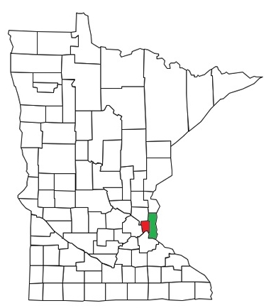
Ramsey/Washington Recycling & Energy
Ramsey and Washington counties have worked together to manage trash responsibly since the 1980s.
Over 800,000 residents and 70,000 businesses
14% of state's population
Public entity responsible for meeting the state of MN’s 75% recycling goal.
Overseen by a joint powers board of Ramsey & Washington County Commissioners.

Slide 4
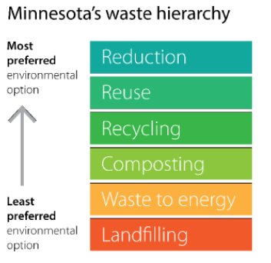
Ramsey & Washington County Solid Waste Priorities
Top Priority – Upstream
Waste reduction, reuse, and repair
Source-separated recycling – reusable items, recyclable items, and food scraps
Outreach and education - behavior change
75% Recycling Goal = Reduction, Reuse & Recycling
Last Option – Downstream
Processing waste for energy
Pulling valuable materials from waste stream
Landfilling as last resort
Notes:
Sam Hanson
Talking points:
here's another way to think about how joint activities and the R&E Center work together. With the waste hierarchy in mind (on the left) - joint activities are our top priority. These programs are designed to address waste upstream in the most appropriate and beneficial way - all through a collaborative approach with both counties. This work requires behavior change, which means it is ongoing and takes time - but it is through these programs that we make progress towards the 75% recycling goal. Waste that isn't reduced, reused, or recycled through upstream efforts will end up at the R&E Center where we continue to find ways to pull value from waste by extracting resources and producing RDF. Together, JA and the facility provide a comprehensive approach to waste management for our two counties.
JA is a top strategy that RC/WC have chosen to address the waste hierarchy and the 75% recycling goal

Slide 5
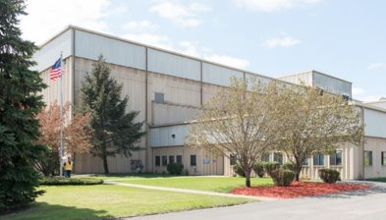
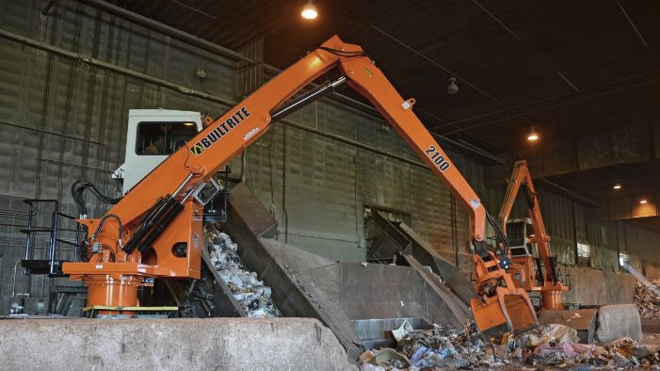
The R&E Center (Downstream Processing)
Located in Newport, MN
Purchased by the two counties in 2016
All trash from residents and businesses in the two counties is delivered here.
Trash is processed into refuse-derived fuel (RDF) used by Xcel Energy to generate electricity.
About 10% is landfilled.
R&E Center manages nearly 13% of the state’s total waste
Notes:
Sam Holl
The Ramsey/Washington Recycling and Energy Center is a waste processing facility owned and operated by the two counties. Both Ramsey and Washington counties have waste designation ordinances that require all MSW generated in the two counties to be delivered to the facility.
The R&E Center produces refuse-derived fuel, or RDF, which is transported to two Xcel waste-to-energy facilities in southern Minnesota for electricity generation. Annually, R&E manages about 450,000 tons of MSW. Our RDF processing line includes ferrous and non-ferrous sortation equipment, and from that we're able to recover about 14,000 tons of metals for recycling each year.
One of the drivers of R&E's work is the state of Minnesota's 75% recycling goal for metro counties by 2030. For about a decade, R&E has been studying how to reach that goal and find more value from waste. That includes investing in the R&E Center to enhance our processes.
FYI 30 years of waste processing results
10.5 million tons of MSW delivered
9.25 million tons processed
8 million tons of RDF produced used by Xcel Energy to generate electricity
400,000 tons of metals recycled
Over the same period:
Source separated recycling went from nearly 0% to over 50%

Slide 6
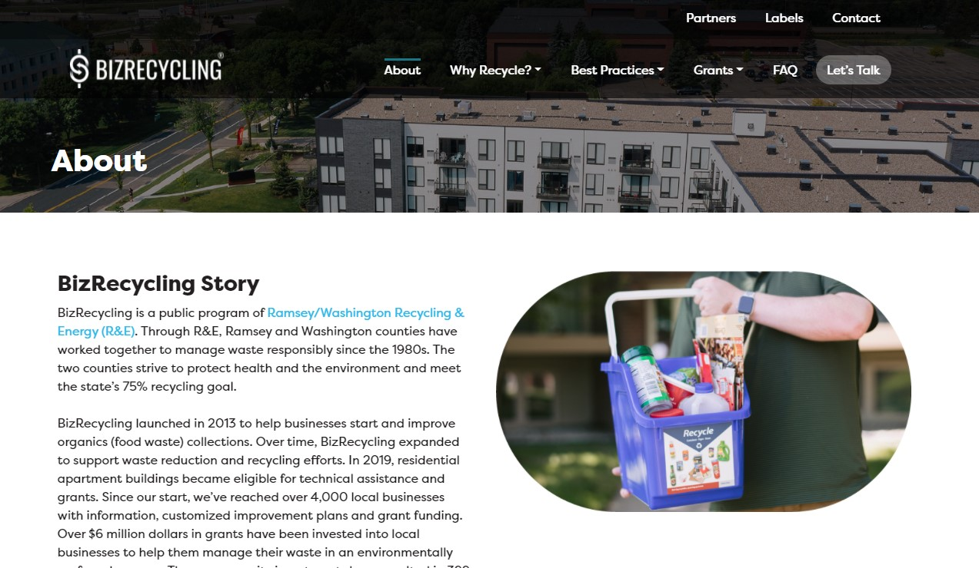
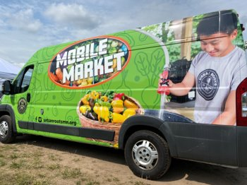
Community Programming (Upstream Prevention Work)
BizRecycling
Technical assistance and grant funding for commercial sector entities.
Technical assistance and grant funding for apartment buildings.
Business Pollution Prevention
Food Waste Prevention
Food Scrap Recycling
Compost Market Development
Mattress Recycling
Deconstruction/C&D Recycling
Reuse & Repair
Outreach and Education

Slide 7
PURPOSE
Increase commercial waste diversion through waste reduction & recycling
HOW
Engagement + Technical Assistance + Grants
TA Providers: EcoConsilium & Minnesota Waste Wise
IMPACT (Food Recovery Grants since 2021)
46 grants awarded
3,815 tons of food waste prevented
Notes:
8 million tons = same amount of estimated plastic entering the ocean every year – Not sure if this number looks out of place giving that R&E is processing 450,000 tons a year.

Slide 8
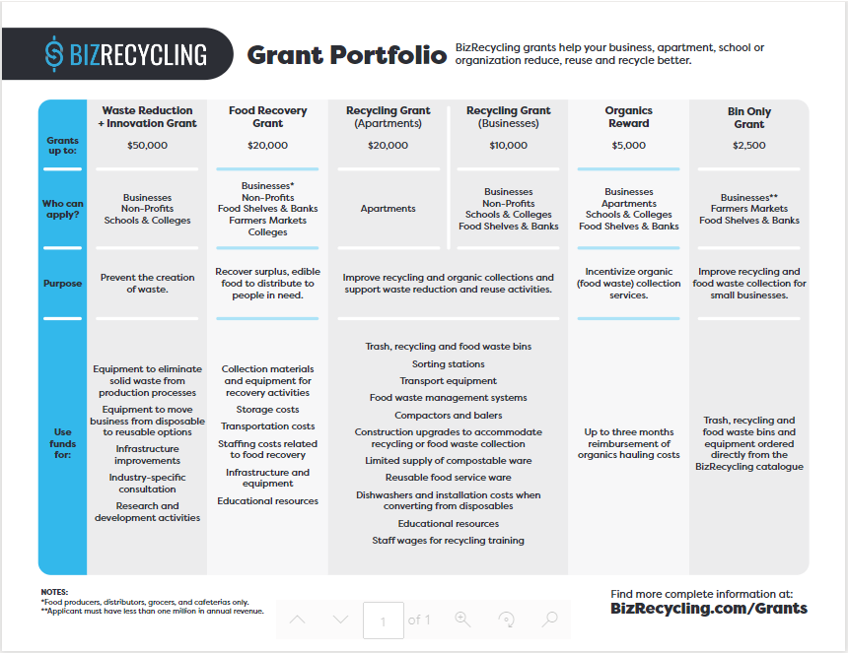

Slide 9
Key Definitions
Food recovery (also known as food rescue):
collection of surplus food from grocery stores, distributors and other sources of safe and edible food that can be redistributed to people who need it
Gleaning:
Collection of surplus produce from farms or farmer's markets distribution to people who need it

Slide 10
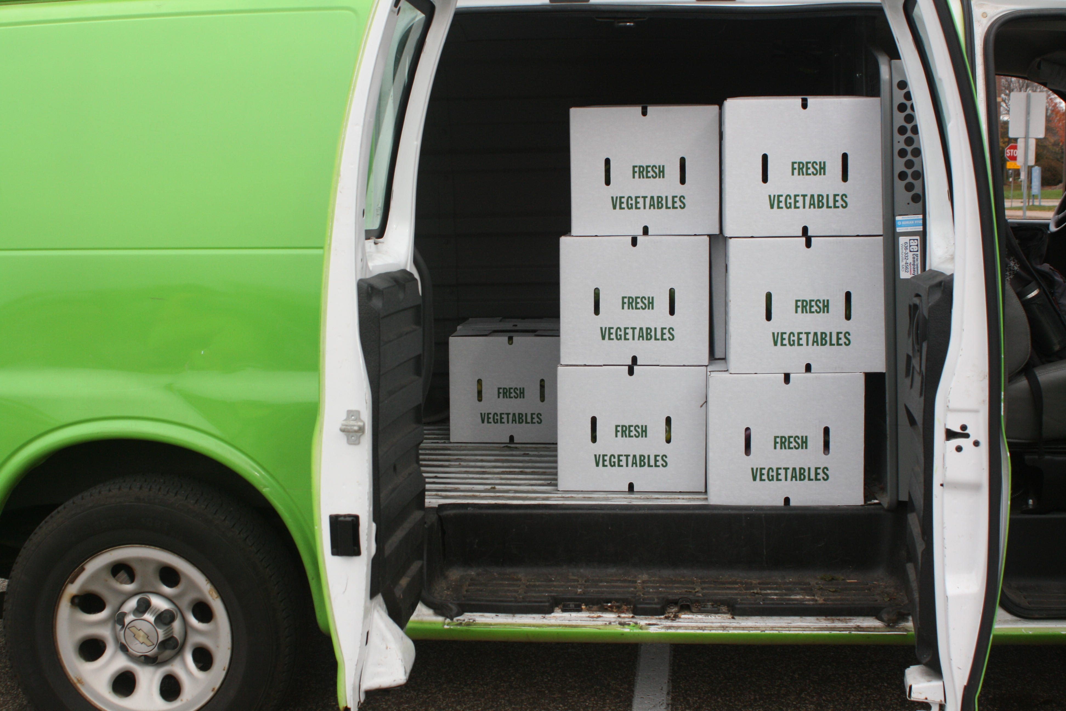
About
Launched in 2021 in response to increased food waste and food insecurity
Purpose: Recover surplus, edible food to distribute to people in need.
Who Can Apply: Businesses (grocery stores, food distributors, cafeterias), non-profits, colleges, churches
Recover and/or donate food in Ramsey or Washington County
Grants awarded per address
Must be able to provide a W9 form
Grant Limit: $20,000
50% of the grant award is provided at project start, 50% via reimbursement, $250 for completing a final report.
Available Funding:
Grants awarded twice annually with option to reapply annually
$300,000 per year available for Food Recovery Grants; awards are given until all funds are dispersed.

Slide 11
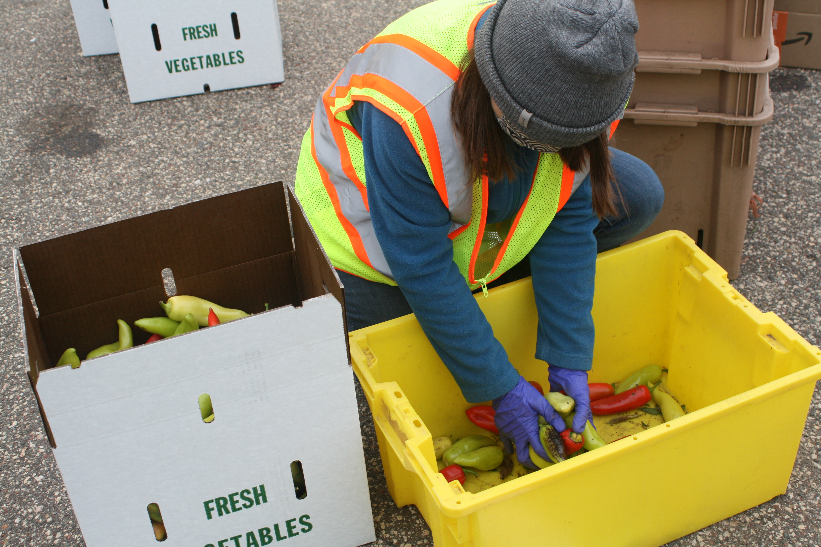
Requirements
Work with a technical assistance provider.
Initial site visit
Application support
Implementation support
Reporting support
Complete a Food Recovery Grant application.
Enter into a contract agreement with R&E for a period of 18 months.
Biannual (twice per year) reports
Mid-term/reimbursement report
Final report questions included in last biannual report

Slide 12
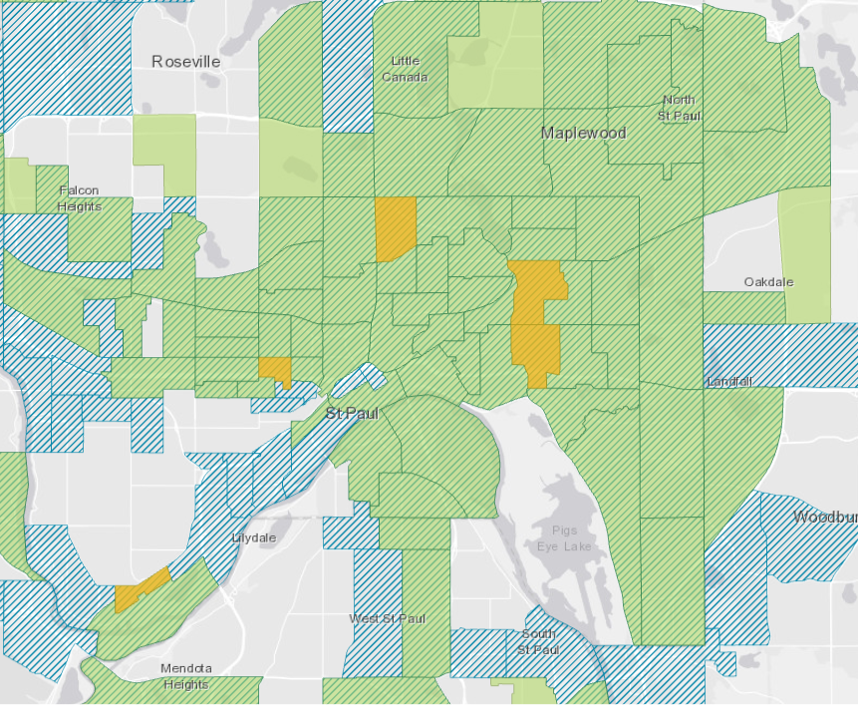
Funding priorities
Priority Projects:
Donation and distribution of culturally-preferred and healthy foods
Food distribution in environmental justice priority areas
Purchases/programs that will sustain food recovery beyond the grant period
Collaborative projects (for example, a food shelf distributing to multiple organizations)
Ineligible expenses:
Purchase of food that is not recovered
Food to be sold
Composting or food-to-animals
Fuel purchase
Source: https://mpca.maps.arcgis.com/apps/MapSeries/index.html?appid=f5bf57c8dac24404b7f8ef1717f57d00

Slide 13
Use of Funds
Materials needed for food recovery activities, including collection materials (buckets, boxes, etc.), materials to assist with food mobility (carts, pallets, etc.)
Storage costs, including rental and/or equipment purchase for storage
Transportation costs, including vehicle rental if necessary. Transportation costs include mileage reimbursement. Fuel costs cannot be reimbursed
Infrastructure and equipment for use in food recovery and donation efforts, including refrigeration and shelving
Funding for staff for recycling education training (hourly wage for each employee for one hour of training)
Staffing costs up to $15,000 or equivalent of .5 FTE, whichever is less, for work directly associated with food recovery and/or gleaning activities

Slide 14
Application Review
Question
Organization description | Inform about organization mission and key objectives/services Describe populations and geographic areas served, providing percentages of client population when feasible
Activities related to food access and justice | Inform about commitment to promoting access to healthy and/or culturally relevant foods Inform about reaching communities disproportionately impacted by food insecurity, climate change and poor health outcomes
Project Activities (MOST IMPORTANT) Be clear and thorough Describe in detail how the funds will be used Provide detailed descriptions of project timeline, locations of activities, plans for distributing and/or collecting food | Informs about specifics of programs Informs about feasibility of programs Informs about the sustainability of programs Provides more detail to supplement budget
Budget and staffing tables Connect to program activities Provide product brand/item types when applicable Provide quotes and/or links to product details Ensure quantity and cost per unit are accurate | Informs about program cost effectiveness Demonstrates understanding of program guidelines Informs about food safety practices (e.g., if NSF-approved equipment is included)

Slide 15
Top Reasons for Denials
Ineligible items requested
High cost per pound of food recovered
Application incomplete or completed with limited detail
Questionable food safety practices

Slide 16
Evaluation
Process
Holistic team review process, looking at criteria below
Recommendations sent to R&E leadership for final decision making
Evaluation Criteria
Food waste prevention volume
Addressing food access and justice (based on activities, communities served)
Cost effectiveness
Sustainability
Feasibility
Additional environmental and community benefits
Size and location of impact
Innovation

Slide 17
Evaluation Criteria
Criteria | Exemplary
Activities Project activities are clearly stated, specific, realistic, and measurable. | The activities described are very clear, concise, and easy to understand. Project activities, including current and proposed operations, equipment, and processes are explained. Clearly defines link between project activities and how food waste will be reduced.
Impact Estimated weight in pounds of food that will be recovered. Addressing food access and food justice are a priority for the work being completed. | Clear demonstration of how the program will result in additional pounds of food recovered. Estimation of food recovery is realistic regarding project activities. Estimated amount of food recovery represents a significant amount of waste prevented. Programming focuses on priority populations, geographic areas and/or foods that are healthy and culturally specific
Other considerations Implementation of a new or innovative approach Addressing gaps in the current food recovery system | Clear demonstration of how proposed work will improve the food recovery system in a unique way Clear demonstration of meeting priority needs in the food recovery system (ex: meats, other high-value foods) Staff roles and tasks clearly outlined
Capacity to complete the work

Slide 18
Evaluation Criteria
Criteria | Exemplary
Engagement How well employees, food recipients/clients and/or the general community are engaged in project activities. | Project activities benefit and involve many stakeholders to increase their knowledge and/or involvement in food recovery activities, benefits, and values.
Sustainability Programming can be sustained beyond the grant period. | Evidence presented that the project/programming can be sustained beyond grant period.
Feasibility Activities, timeline, and budget are realistic and fit within project description and outcomes. | Project activities, timeline, and budget are congruent with project description and anticipated outcomes.
Budget | Budget clearly supports project activities and impacts. Items are eligible for funding.

Slide 19
Winter/Spring 2025 Timeline
Next Steps
Timeline
Work with your TA to complete application.
Application and materials available at bizrecycling.com/grants/food-recovery-grant/
Feb. 14 – Applications Due
Mid-March – Award announcements
Late Mar./early April – Contracts done
April - Payments made

Slide 20
Question & Answer Period

Slide 21
Connect with Us
BizRecycling Staff
Technical Assistance Providers
Site visits
Project planning
Grant assembly and submittal
EcoConsilium
Jodi Taitt
jodi@ecoconsilium.com
Minnesota Waste Wise
Alboury Ndiaye
Andiaye@mnchamber.com
Get assigned a TA provider
Grant, contract, and payment assistance
Jessica Paquin
jessica.paquin@recyclingandenergy.org
651-259-1845
Leslie Duling McCollam
Leslie.mccollam@recyclingandenergy.org
651-600-7160

